Slide 1
ANR/Links Overview
June 30, 2011

Slide 2
Agenda
ANR/Links Portfolio
End-To-End Architecture / Message Formats Overview
GNS : Features & Flows
Global Prepaid
SNA Decomm / IP Enablement / GAN Migration / Access Codes
Our support for Foursquare & Facebook (Registered Card)
Notes:
Need to solidify agenda
Following pages should be titled the same as the agenda

Slide 3
Authorization Network Routing
WWCAS - Where does the ANR portfolio fit in?
MVS Reports:
CAS-MIS
Transaction Details
Financial
Direct Debit
Audit
etc.
GNS Operations
Centers
GNS Partners / Global
Prepaid / V/MC…
Internet Sources
Direct Links
Third-Party Links
S/E’s
Financial Services ATMs
Relayer
DCP/
GAN
AXP-owned ATMs
F
I
L
E
E
X
T
R
A
C
T
S
Service Establishment
Voice
Response
T
P F
F
I
L
E
F
E
E
D
S
CAS-FAS-POS
OTHER
GRMS
Negative Bulletins
Drafting
Enrollment
FINCAP
Mailers
Currency Exchange Rates
TRICS
RCPS
GNS Partners
CID
GRMS
A/R: Optima, Corporate, International
Embossing Sites
CC90s
Triumph
GNS Partners
TRICS
Express Cash Enrollments
ACH Returns
Encryption
NAC
NAC
Authorizer's Assistant Expert System
Authorizers
IMS, CICS, Triumph, Globestar, Regional C/M Systems
Travel
Financial
System
DCP = Distributed CAS Platform
GAN = Global Auth Network
NAC = Network Access Controller
POS = Point of Sale
VATM = Virtual ATM
POS Terminals, Express 3000 Data Capture, & VATM
Notes:
WOW!!!!
Very overwhelming
How an we skinny this down
RED = GNS (focus of meeting – but entire diagram shows entire team)

Slide 4
End-to-End Technical Architecture
AMEX ISO 8583 GCAG
GNS ISO 8583
ANSI X4.A11
ANSI X9
ISO 8583 v0 (Express 3000)
Visa 1 (dial POS)
Specialty (IBRO, NCR, Merchant Prop)
Other Company
Issuer
Cardholder
Acquirer
Global Prepaid
LINKS
Auth A Charge
GPT
OCAV
GNS
LINKS
DCP/
GAN
DCP
Global Network
Services
Issuer
GAN
Host system
of record
data*
MVS
Neg / VIP
File
AMEX
*Host system of record data includes:
Remote negative
Stand-in limits
GT table
Link directory table
Currency conversion
GNS
GNS Fee
Assessment
Bank Card
Billing
OCAV
Global Prepaid
File Transfer
Notes:
Looks like a lot of this text can be talking points……..
Lots of arrows – can we make this more of a “big picture” with some more detail?
This flow diagram illustrates the flow of information from Cardholder at the Point-of-Sale (POS), through the Acquiring Partner (Merchant/Third Party) to the American Express Authorization Network. The Authorization Request will then be routed to the Card Issuer Authorization System (i.e., Authorize a Charge for Amex Proprietary, Other Company (OCAV)/ Global Network Services (GNS) / Stored Value (SVCAP/EFD)) for Risk Analysis, and the Authorization Response returned to the POS origin. Business Supporting Activities (Reporting, Fee Assessment, Card Holder Status) are also represented.

Slide 5
GNS / DFM
Dynamic Fraud Modeling : A fraud risk management capability in WWCAS for GNS partners
Improved detection of fraudulent charges by utilizing DAC and fraud modeling solutions
Fraud models used to score cardmembers by utilizing current and historical transaction patterns, plus fraud reported by partners and other merchant level data
Scores used (in conjunction with other risk variables) to create DAC rules that derive an Amex recommendation that is forwarded to the Issuer to mitigate fraud
DAC Provides the ability to:
Build custom rules based on modeling variables
Provide a Fraud recommendation to the issuer
Provide Fraud capabilities in stand-in
Provide the ability to decision on behalf of the issuer

Slide 6
GNS Stand-In
Stand-In Triggers:
Partner Maintenance (Scheduled Stand-In)
Issuer Time-Outs / Slow Response Time (Unscheduled Stand-In)
Remote Stand-In (DCP or GAN) due to scheduled or unscheduled CAS downtime
Stand-In Processing Parameters:
Partner defined limits (single or velocity charges)
Special VIP limits
CSC checking
Negative Look-Up
Dynamic Fraud Modeling checking (DFM)
Post Decision Activities:
Transmit decision to merchant
Post-authorization advices to GNS issuer
Log transaction decision
Reporting:
Log data transmitted to GNS data warehouse
Monthly / Daily reports sent to GNS Issuers

Slide 7
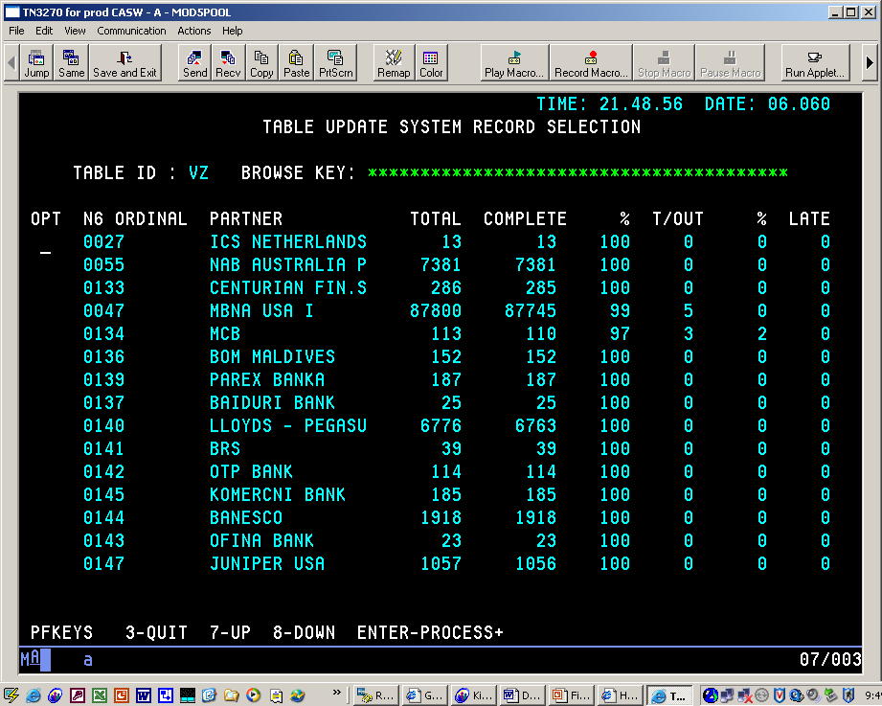
Authorization Network Routing

Slide 8
Authorization Network Routing

Slide 9
Authorization Network Routing

Slide 10
Authorization Network Routing
ANR/Links Prepaid

Slide 11
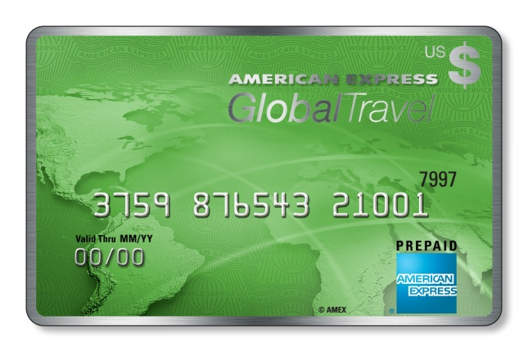
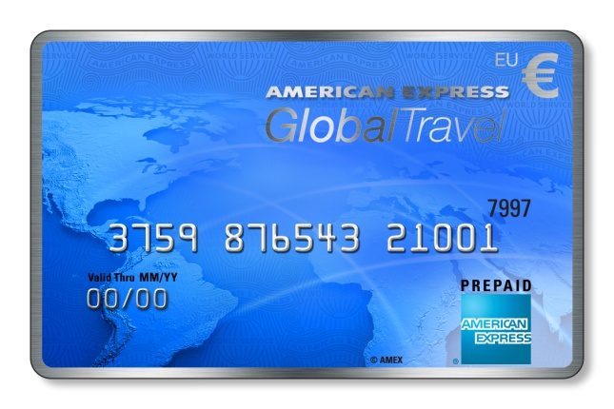
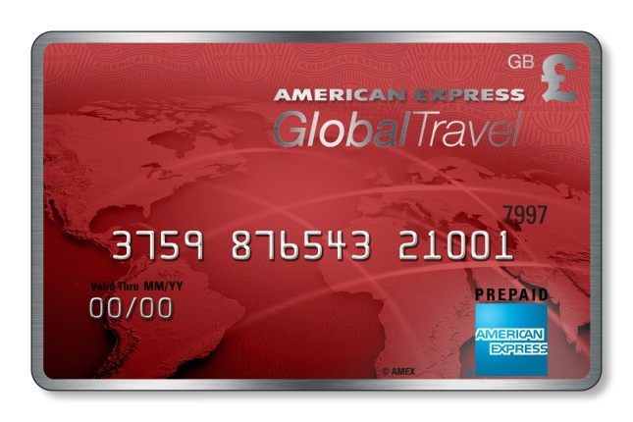
Authorization Network Routing
History of Amex stored value
- Private payments 2000
- Creations of Stored Value, e.g. system in SLC, new code
2004
- decision to outsource prepaid processing to Wild Card /
eFunds / FIS
- outsourcing timeline
2006 – decide to outsource
2007 – work to get eFunds / FIS functional
2008 – continue to add functionality to FIS, e.g.
balance updates, BOL, unique Seller ID, MQ,
Alternate Line processing.
2009 – more functionality, e.g. international spend, launch prepaid Canada card, start PDAC
project and MIVR.
2010 – spin off the AEIS cards (~2.7MM) to
InteliSpend / TxVia, complete the card data
migration (~110MM) from GPP/SVCAP to FIS and unplug GPP/SVCAP in Oct 2010
Notes:
- The Canada prepaid card was originally issued with the restriction that it could only be used within Canada. This was the first time that Links needed to implement a means of denying transactions that were not in Canadian currency.
- The PDAC project implemented the ability for the Links prepaid code to access a subset of DAC rules that are specific to prepaid transaction. It also did some pre-verification of the SE number and the CSC value. Recommendations of approve or deny based on that verification and / or the PDAC analysis are passed to FIS for their direction / consideration. The successful completion of this project gave the Global Prepaid Risk team a major boost for fraud prevention.
- The spin-off of the AEIS cards created a new opportunity and revenue stream. InteliSpend and their chosen processing partner decided to implement with Amex as a GNS vendor, not a prepaid vendor like FIS. It was directly because of this that CAS and GNS were able to work together to implement the basic prepaid functionality into the Links GNS code. Now new and existing GNS partners wishing to issue Amex co-branded prepaid cards have the means to do so.

Slide 12
Authorization Network Routing
New Products Since Then
- Merchant Initiated Void Reveral – 3/2010
- Teen or PASS Card – 5/2010 announced on 8/2010
- Australia Travel Cards – 06/2010
- Canada Cross Border – 8/2010
- Sales Person Incentive Card – est. launch 11/2010
- Brazil Travel Cards – 12/2010
- Target General Purpose Reloadable Cards – 2/2011
- Sprint Consumer Incentive Card –2/2011
- American Express Prepaid Card – 6/2011
New Products in the Works
- AAA / Amex Travel Cards – est. launch 8/2011
- US Student ID Card – est. launch 8/2011
- India Gift Card – est. launch 8/2011
- China Travel Card – est. launch 9/2011
- South Africa Travel Card – est. launch 9/2011
- Japan Prepaid Card – est. launch 10/2011
On the Horizon
- Contactless Prepaid Cards – in pre-PDP
- EMV Chip and PIN
Notes:
- MIVR is a unique reversal in that while it is still considered an advice message, they are processed as real-time transactions.
- PASS cards can be used like any prepaid card except that they are age restricted, e.g. for teenagers only. These cards can also be used at ATMs and internationallly.
- The Australia Travel card presented Links with an unique issue. Similar to the Canada prepaid card, the Australia Travel card had a usage restriction. However, where the Canada card could only be used in Canada, the Australia Travel card could NOT be used in Australia. Links devised a solution by expanding a TMS table used solely to support prepaid cards. Now with a simple update to this TMS table, we can allow or disallow the currencies that a prepaid card can be redeemed in. We have been able to use this feature in all of the subsequent travel card projects with the exception of the AAA / Amex travel card which does not have any currency restrictions.
- The travel cards are sold in USD, EUR or GBP only and are high value cards. They are sold in pairs, one active and one dormant. That way if the traveler finds this card is lost or stolen, he can call a CSR who will deactivate the first card so that it can not longer be used and active the dormant card so the traveler can continue to access his funds.
- A modification was made so that the Canada prepaid card could be used in the US as well as Canada.
- The Sprint consume incentive card will be the first Amex rebate card.
- The Amex prepaid has all of the capabilities of the PASS card but does not have an age restriction.
- The US Student ID card is reloadable and can have any student load funds loaded to this card. While many existing student IDs can do that today, those cards can only be used on that campus. This new ID can be used as a regular prepaid card. While some parents may worry about where Jr will be using it, they can have some peace of mind. Transactions for these card will be rejected if they are used at specific businesses, e.g. liquor stores, casinos, etc.
- The India gift card product is unique in that it is being created to b sold in bulk, much like the Sales Person Incentive Cards.

Slide 13
Authorization Network Routing
Continued Enhancements to Links
- Adding ACCUM data to the existing balance database.
Uplifting the existing PDAC.
- Preparing to work with GNS to create balance-based stand in capabilities for GNS cards. This may include creating the means of allowing / processing the unique, prepaid message type of a funding.
Notes:
- - With the ACCUMs Global Payments Options – Risk will be able to detect fraud by the number and types of transactions. ACCUMing will be done only for relationship cards.
- Currently CAS does not have the capability of decisioning GNS transactions during stand in outside of a few parameters. By adding a balance database by card, CAS will have better capability to approve or deny transaction.

Slide 14
SNA Decomm / IP Enablement / GAN Migration / Access Codes
Part of Data Center 2015.
Say Goodbye to the 60’s and hello to the 90’s!
Move off of Stratus/DCP to GAN (Global Area Network).
IP-Enable Stratus/DCP when unable to move to GAN
Improved network capability and reliability.
Network is up almost immediately after an IPL.
Multiple Connections to each GAN node and Stratus.
Dynamically route to a working connection.
Access Codes
What are they?
Unique Logical Identifer
How are they used for routing?
Internal to DCP/GAN & CAS
Key to Link Directory
Notes:
Please add some Access Code notes!

Slide 15
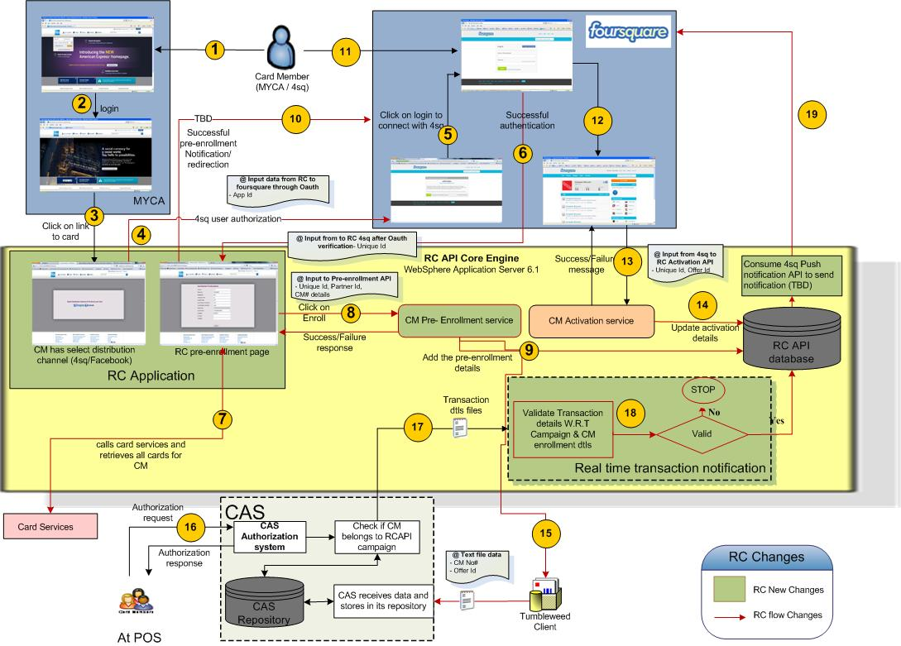
FourSquare, Facebook @ more (Registered Card)
2 new database elements for GNS (Domestic and International) to allow our GNS partners to participate in new social partnership programs.
Create association with card member and promotion program.
Prepaid partnership upcoming.

